Slide 1

OEBB 2021-22
Open Enrollment
All Plans Webinar

Slide 2


Medical and pharmacy

Slide 3
Plans and network options
All Moda Health medical plans 1-7 will use the large Connexus Network
  Service area is statewide
  Coordinated and non-coordinated-care options
  Moda 360 with all plans
Retirees and COBRA members living outside of the Connexus service area use Moda Health’s rental networks:
  First Choice Health Network (FCH) for residents in Washington and Montana (excluding southwest Washington)
  The Private HealthCare Systems (PHCS) is available to residents of all other states
To search for in-network providers, you can use our online provider directory, Find Care or call a Moda 360 Health Navigator

Slide 4
Moda Health medical plans
Medical plan | Deductible |  | Out-of-pocket |  | Primary care |  | Specialist care |  | Urgent care
 | Coordinated | Non-coordinated | Coordinated | Non-coordinated | Coordinated | Non-coordinated | Coordinated | Non-coordinated | Coordinated | Non-coordinated
Plan 1² | $400 | $500 | $2,850 | $3,250 | $20¹ | 20% | $40¹ | 20% | $40¹ | 20%
Plan 2² | $800 | $900 | $3,850 | $4,250 | $20¹ | 20% | $40¹ | 20% | $40¹ | 20%
Plan 3² | $1,200 | $1,300 | $4,850 | $5,250 | $25¹ | 25% | $50¹ | 25% | $50¹ | 25%
Plan 4² | $1,600 | $1,700 | $6,700 | $7,100 | $25¹ | 25% | $50¹ | 25% | $50¹ | 25%
Plan 5² | $2,000 | $2,100 | $6,800 | $7,200 | $30¹ | 25% | $50¹ | 25% | $50¹ | 25%
Plan 6² HSA optional | $1,600 | $1,700 | $6,400 | $6,750 | 15% | 20% | 15% | 20% | 15% | 20%
Plan 7² HSA optional | $2,000 | $2,100 | $6,500 | $6,750 | 20% | 25% | 20% | 25% | 20% | 25%
¹Deductible waived
²If enrolled in a Moda Health medical plan, each covered individual must choose a PCP 360 with Moda Health to receive the enhanced “coordinated” benefit under that plan when using a provider in the Connexus Network. If an individual has not chosen a PCP 360 with Moda Health, they will receive the “non-coordinated” benefit shown in the right column, if using a provider in the Connexus Network.

Slide 5
How to participate in coordinated care and receive enhanced benefits
Choose a PCP 360
with Moda Health
A PCP 360 is a primary care provider who is willing to partner with the member and provide higher-quality care
Each member of your family gets a choice
Each enrolled member can choose their own PCP 360 and whether they would like to participate in coordinated care
Use your PCP 360
for all of your primary care needs
No referrals required to see specialists
Choose a PCP 360 at anytime during the year
Enhanced benefits are effective the first of the month in which you make the selection
Premium is the same
for coordinated care or non-coordinated care
The premium for a plan does not change whether a member chooses coordinated or non-coordinated care

Slide 6


How to choose a Moda Health PCP 360
Call a Moda 360 Health Navigator at 866-923-0409. You can also message one instantly through your Member Dashboard or email them at oebbquestions@modahealth.com.
Log in to your
Member Dashboard
Each enrolled member can choose their own PCP 360
The subscriber of the plan may also choose a PCP 360 for all covered members, including their spouse or domestic partner and dependents, even if they are over the age 18

Slide 7
High Deductible Health Plans 6 and 7
High Deductible Health Plans (HDHPs) can be paired with a Health Savings Account (HSA), but members are not required to contribute to an HSA to be enrolled in plans 6 and 7
Preventive services covered in full; all other services are subject to the deductible
and coinsurance
  Pharmacy expenses are also subject to the medical deductible with the exception
  of value-tier drugs. These drugs are covered at a low copay and do not apply to
  the deductible.
Members who cover one or more dependents must meet the family deductible before the plan will pay for services
Deductible and coinsurance both accrue toward the member’s out-of-pocket maximum

Slide 8
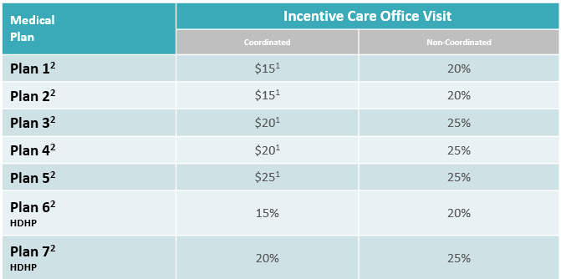
Incentive care benefits
The coordinated care benefit includes an incentive care office visit with a PCP 360 or specialist for chronic conditions such as asthma, heart conditions, cholesterol, high blood pressure and diabetes
¹Deductible waived
²If enrolled in a Moda Health medical plan, each covered individual must choose a PCP 360 with Moda Health for that individual to receive the enhanced “coordinated” benefit under that plan when using a provider in the Connexus Network. If an individual has not chosen a PCP 360 with Moda Health, they will receive the “non-coordinated” benefit shown in the right column if using a provider in the Connexus Network.

Slide 9
Pharmacy benefits
 | Medical plans 1-5 | Medical plans 6-7
Out-of-pocket maximum | Accrues toward maximum cost-share | Accrues toward out-of-pocket max
 |  | Coordinated care | Non-coordinated care
Value | $4 per 31-day supply | $4* per 31-day supply | $4* per 31-day supply
Select generic | $12 per 31-day supply | 20% | 25%
Preferred brand | 25% up to $75 per 31-day supply | 20% | 25%
Non-preferred brand** | 50% up to $175 per 31-day supply | 20% | 25%
Mail
Value | $8 per 90-day supply | $8* per 90-day supply | $8* per 90-day supply
Select generic | $24 per 90-day supply | 20% | 25%
Preferred brand | 25% up to $150 per 90-day supply | 20% | 25%
Non-preferred brand** | 50% up to $450 per 90-day supply | 20% | 25%
Specialty***
Generic | $12 per 31-day supply or $36 when allowed 90-day supply | 20% | 25%
Preferred brand | 25% up to $200 per 31-day supply | 20% | 25%
Non-preferred brand** | 50% up to $500 per 31-day supply | 20% | 25%
*Deductible waived
**A formulary exception must be approved for non-preferred brand prescription medication
***Allows 90-day fills for select specialty medications (2 times the copay)

Slide 10

Pharmacy changes
Moda Health will change its pharmacy benefit manager to Navitus Health Solutions on October 1, 2021
All Moda Health Medical members will receive a new ID card with new information to share with their pharmacies
If you have not yet received your new ID card – the following information will need to be updated at your Pharmacy:
    Bin: 610602
    PCN: NVT
    Rx Group: OEBB
    You can download a digital copy of your ID card from your Member Dashboard at modahealth.com/memberdashboard

Slide 11

Pharmacy (Effective 10/1/21)
Starting 10/1/2021 Walgreens will be an in-network pharmacy and CVS will be an out-of-network pharmacy. Members impacted by a pharmacy network change will be sent a letter at least one month in advance
  Please reference the letter for any action needed. You may receive more than one letter if you are affected by more than one change
  You can use the Pharmacy search tool in your Member Dashboard to search for network pharmacies
Costco will be an in-network mail order pharmacy in addition to Postal Prescription Services (PPS)
Members impacted by a formulary change will be sent a letter about the change two months in advance
  Please reference the letter for any action needed. You may receive more than one letter if you are affected by more than one change
Members with a current pharmacy prior authorization on file will not need to seek a new prior authorization
To continue to access your previous prescription claims history, please log in to your Member Dashboard prior to 9/30/21. Then select the Pharmacy tab on the top of the screen and click the MedImpact member portal link in the Resources box. Click Here

Slide 12
Out-of-area coverage
College students
College students | Other members
Dependents who live part-time outside of the Connexus Network service area (like college students) can still choose a PCP 360 for coordinated care and receive enhanced benefits Members must update the dependent’s address change in MyOEBB for access to our travel network for in-network benefits away from home Primary care from someone other than their designated PCP 360, will be at the “not my chosen PCP 360” benefit level | Early retirees, COBRA members and dependents who live full-time outside of the Connexus Network service area are not eligible for the enhanced benefits associated with coordinated care

Slide 13



Slide 14
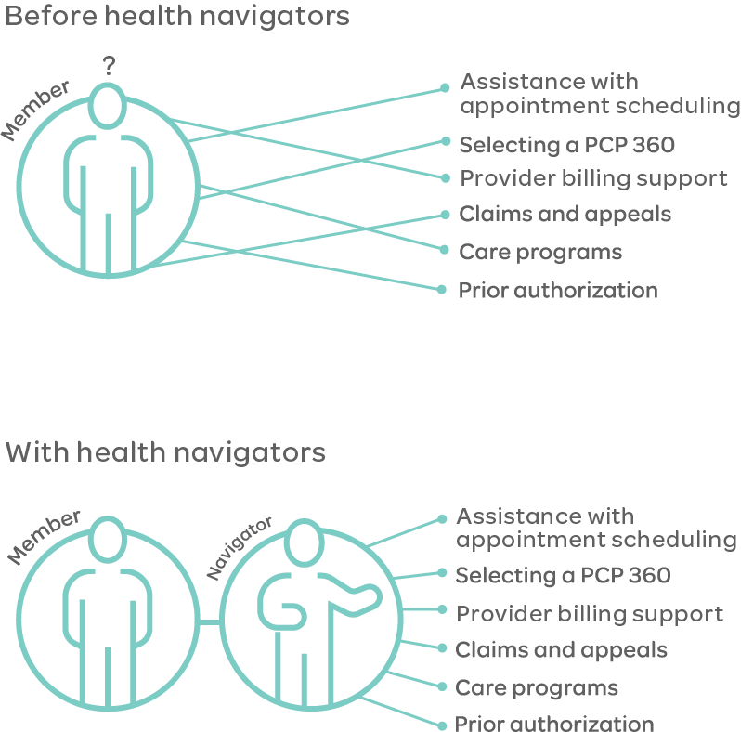
| Health Navigator team
Moda 360 Health Navigators will help you navigate the sometimes-complex health care system
This means every time you call the Moda Health OEBB member phone number, you will be connected with a Moda 360 Health Navigator
The Health Navigator will assist you with any questions you may have, and will also serve as your guide to connect you with the care, resources and programs that best fit your needs

Slide 15


| CirrusMD
Text a Doctor
  The CirrusMD app connects you with a doctor via text, 24/7 with no cost-sharing. The app allows members to:
    Ask urgent or general health questions
    Message, share photos or video chats
  Provides convenience and flexibility, and is available in all 50 states
  Providers can also prescribe medications
  Can access through Member Dashboard or the CirrusMD website

Slide 16

| Meru Health
A specialized behavioral health support app that helps reduce stress, depression, anxiety and burnout with a 12-week treatment program
The program offers:
  Confidential access to a personal, remote therapist
  Mindfulness and behavioral techniques that can be practiced anytime
  Wearable biofeedback training to increase focus and manage stress
  Can access through Member Dashboard or the Meru Health website

Slide 17
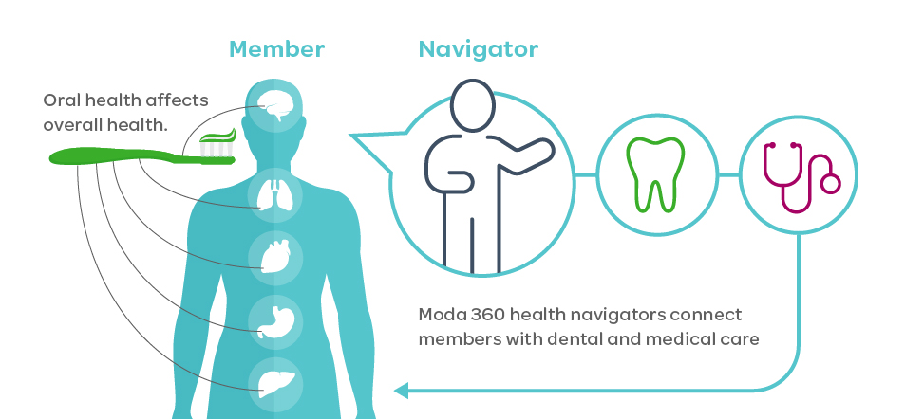
| Dental integration
We are adding dental integration to our Moda 360 program
This means if you are enrolled in a Moda Health medical and Delta Dental plan, you will be connected to a Moda 360 Health Navigator
The Health Navigator can help members with:
  Claims and provider billing support
  Finding providers
  Connections to providers
  participating in the Health through
  Oral Wellness® program
  Connections to appropriate
  programs, tools and resources

Slide 18

Vision

Slide 19
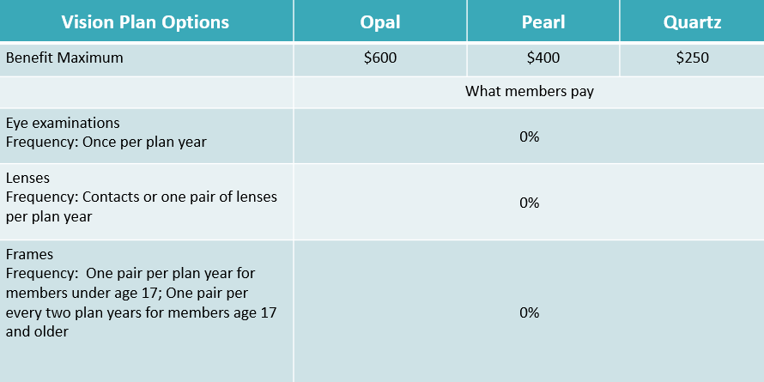
Vision plan options – no changes

Slide 20

Vision – key things to remember
You may see any licensed ophthalmologist, optometrist
or optician
Receive discounted rate from a Moda Health-contracted provider (use Find Care ― Moda Health’s online provider directory)
Benefits run on a plan year basis (Oct. 1 – Sept. 30)
Benefit maximum includes exam and hardware

Slide 21


Dental

Slide 22
Delta Dental plans overview
No plan design changes to existing plans
Delta Dental added a *NEW* Exclusive PPO – Incentive Plan
There is no out of network coverage on the Exclusive PPO Plans.
  If enrolled in either of these plans, you must see a Delta Dental PPO provider for benefits to be covered.

Slide 23
Dental plan options
Plan options | Plan 1 | Plan 5 | Plan 6 | Exclusive PPO – Incentive plan | Exclusive PPO Plan
Network | Delta Dental Premier |  |  | Delta Dental PPO | Delta Dental PPO
Deductible | $50 | $50 | $50 | $50 | $50
Benefit maximum | $2,200 | $1,700 | $1,200 | $2,300 | $1,500
In-network, members pay
Preventive/diagnostic | 30% - 0% | 30% - 0% | 0% | 0% | 0%
Restorative | 30% - 0% | 30% - 0% | 20% | 30%-0% | 10%
Major restorative - crowns/onlays | 30% - 0% | 30% | 50% | 30% - 0% | 20%
Prosthodontic - implants | 30% - 0% | 50% | 50% | 30% - 0% | 20%
Orthodontic (lifetime maximum - $1,800) | 20% | 20% | N/A | 20% | 20%
Occlusal guards (night guards* and athletic mouth guards) | 50% | 50% | 50% | 50% | 50%
Nitrous oxide | 50% | 50% | 50% | 50% | 50%

Slide 24
Delta Dental Networks
The Delta Dental Premier Network (Plans 1, 5 and 6) is the largest dental network in Oregon and nationwide
  Over 2,400 providers in Oregon and over 156,000 providers nationwide
The Exclusive PPO plan uses the Delta Dental PPO Network
  Over 1,300 providers in Oregon and over 112,000 providers nationwide
  You must use a Delta Dental PPO provider and there are no out-of-network benefits for these plans

Slide 25
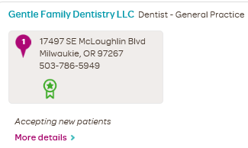
Health through Oral Wellness® (HtOW)
All OEBB members have access to the HtOW program
  Patient-centered wellness program that helps members maintain better oral health through a risk assessment, education and additional evidence-based preventive care
Providers participating in the program use an oral health assessment to find out the member’s risk of tooth decay, gum disease and oral cancer
Members may qualify for the following services depending on their risk score:
  Additional cleanings
  Fluoride treatment
  Sealants
  Periodontal maintenance
  Nutritional counseling
To see which providers are participating in
HtOW, members can look for a green badge
shown in Find Care
If your provider is not registered with for HtOW, you can have them participate by calling our Health through Oral Wellness provider line: 844-663-4433
For more details on HtOW – please see our website: deltadentalor.com/oralwellness/members/

Slide 26


Member resources

Slide 27
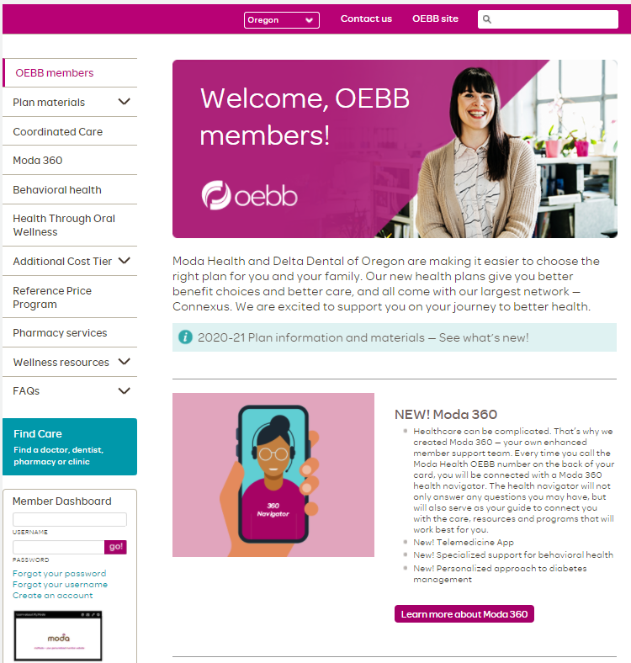
modahealth.com/oebb
Want to learn
more about
your wellness resources or behavioral health?
Choosing your PCP 360? You’ll need to log in to your Member Dashboard and look for the
PCP tab
Want more details on Moda 360?

Slide 28
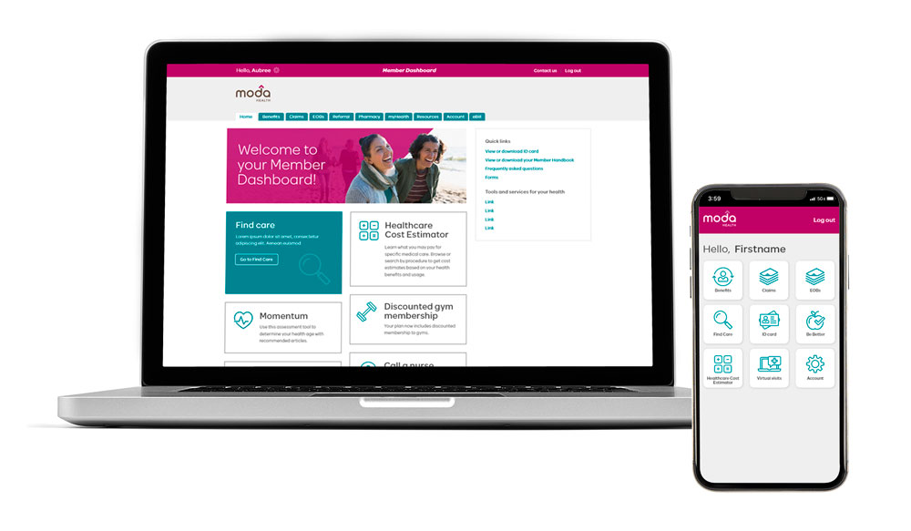
Member Dashboard – your personal member website
See your benefits and Member Handbook
Choose a PCP 360
Check claims and review electronic
explanations of benefits (EOBs)
Download your member ID card
Access member care resources
  Health coaching
  Prescription Price Check
  Healthcare Cost Estimator
Access Moda 360 digital resources
  Cirrus MD
  Meru Health
  *NEW* Chat with a Moda 360 Health Navigator

Slide 29
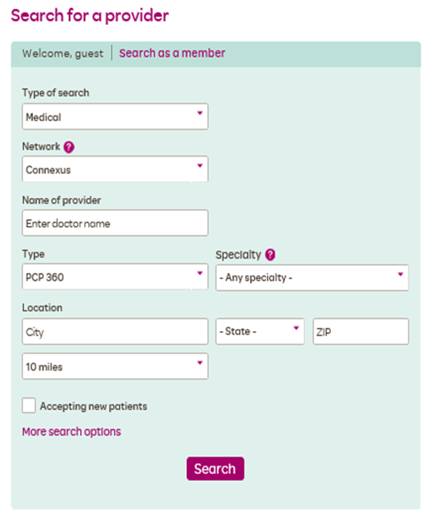
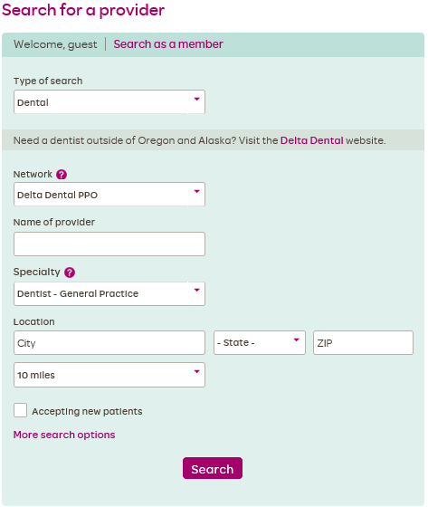

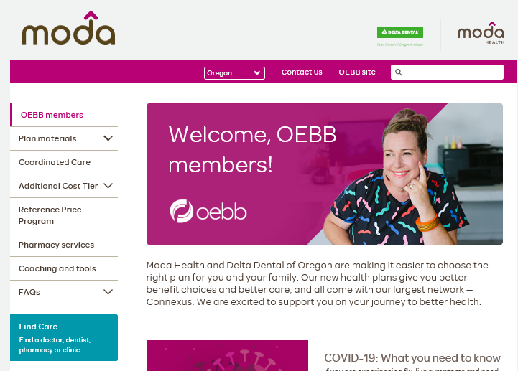

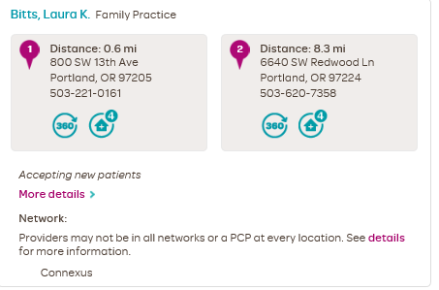
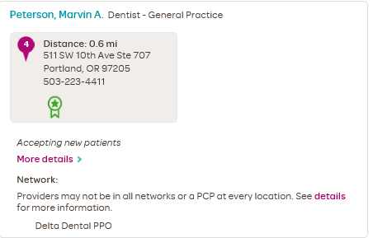
Find Care – Moda Health’s online provider directory
Search for providers in your network
Click on Find Care on the Moda/OEBB homepage

Slide 30


| Health Navigators
Available Monday through Friday from 7:30 a.m. to 5:30 p.m. Pacific time.
Medical/Vision
866-923-0409
Pharmacy
866-923-0411
Dental
866-923-0410
Or email Moda at OEBBquestions@modahealth.com
You can also message a Health Navigator instantly through your Member Dashboard

Slide 31
Thank you

