Slide 1

OEBB 2021-22
Open Enrollment:
Dental Plans

Slide 2
Delta Dental plans overview
No changes to existing plans
Delta Dental added a *NEW* Exclusive PPO – Incentive Plan
There is no out-of-network coverage on the Exclusive PPO Plans
  If enrolled in either of these plans, you must see a Delta Dental PPO provider for benefits to be covered

Slide 3
Dental plan options
Plan options | Plan 1 | Plan 5 | Plan 6 | Exclusive PPO – Incentive plan | Exclusive PPO Plan
Network | Delta Dental Premier |  |  | Delta Dental PPO | Delta Dental PPO
Deductible | $50 | $50 | $50 | $50 | $50
Benefit maximum | $2,200 | $1,700 | $1,200 | $2,300 | $1,500
In-network, members pay
Preventive/diagnostic | 30% - 0% | 30% - 0% | 0% | 0% | 0%
Restorative | 30% - 0% | 30% - 0% | 20% | 30% - 0% | 10%
Major restorative - crowns/onlays | 30% - 0% | 30% | 50% | 30% - 0% | 20%
Prosthodontic - implants | 30% - 0% | 50% | 50% | 30% - 0% | 20%
Orthodontic (lifetime maximum - $1,800) | 20% | 20% | N/A | 20% | 20%
Occlusal guards (night guards* and athletic mouth guards) | 50% | 50% | 50% | 50% | 50%
Nitrous oxide | 50% | 50% | 50% | 50% | 50%

Slide 4
Delta Dental Networks
The Delta Dental Premier Network (Plans 1, 5 and 6) is the largest dental network in Oregon and nationwide
  Over 2,400 providers in Oregon and over 156,000 providers nationwide
The Exclusive PPO plan uses the Delta Dental PPO Network
  Over 1,300 providers in Oregon and over 112,000 providers nationwide
  You must use a Delta Dental PPO provider and there are no out-of-network benefits for these plans

Slide 5
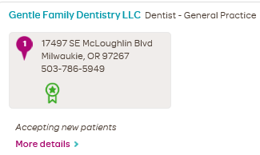
Health through Oral Wellness® (HtOW)
All OEBB members have access to the HtOW program
  Patient-centered wellness program that helps members maintain better oral health through a risk assessment, education and additional evidence-based preventive care
Providers participating in the program use an oral health assessment to find out the member’s risk of tooth decay, gum disease and oral cancer
Members may qualify for the following services depending on their risk score:
  Additional cleanings
  Fluoride treatment
  Sealants
  Periodontal maintenance
  Nutritional counseling
To see which providers are participating in
HtOW, members can look for a green badge
shown in Find Care
If your provider is not registered for HtOW, you can have them call our Health through Oral Wellness provider line: 844-663-4433
For more details on HtOW – please see our website: deltadentalor.com/oralwellness/members/

Slide 6




Slide 7
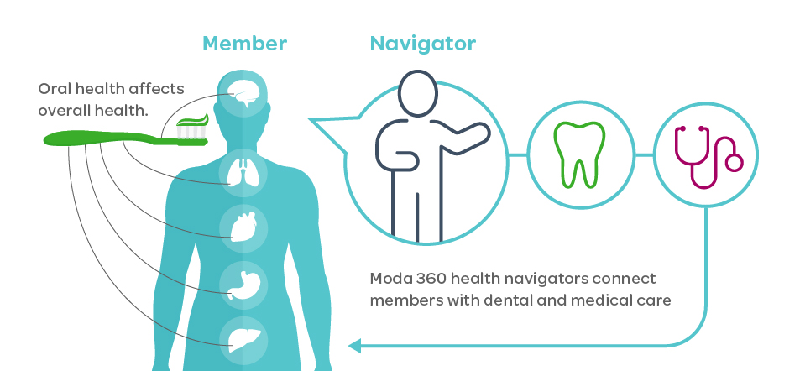
| Dental integration
We are adding dental integration to our Moda 360 program
This means if you are enrolled in a Moda Health medical and Delta Dental plan, you will be connected to a Moda 360 Health Navigator
The Health Navigator can help you with:
  Claims and provider billing support
  Finding providers
  Connections to providers
  participating in the Health through
  Oral Wellness® program
  Connections to appropriate
  programs, tools and resources

Slide 8


Member resources

Slide 9
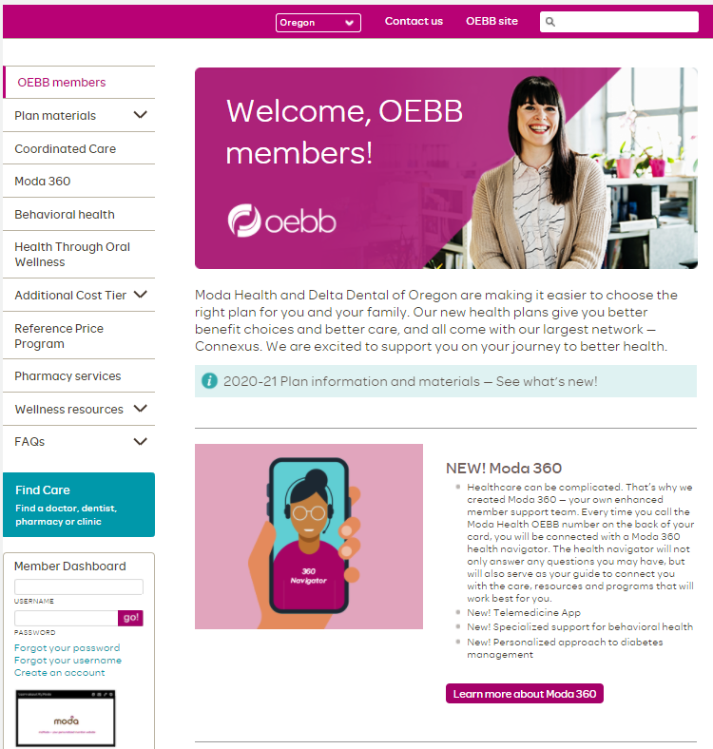
modahealth.com/oebb
Have questions about our dental networks or how incentive level plans work? Check out our Dental FAQ, located here!
Looking for details on your coverage? Log in to your Member Dashboard here
Want more details on Moda 360?

Slide 10
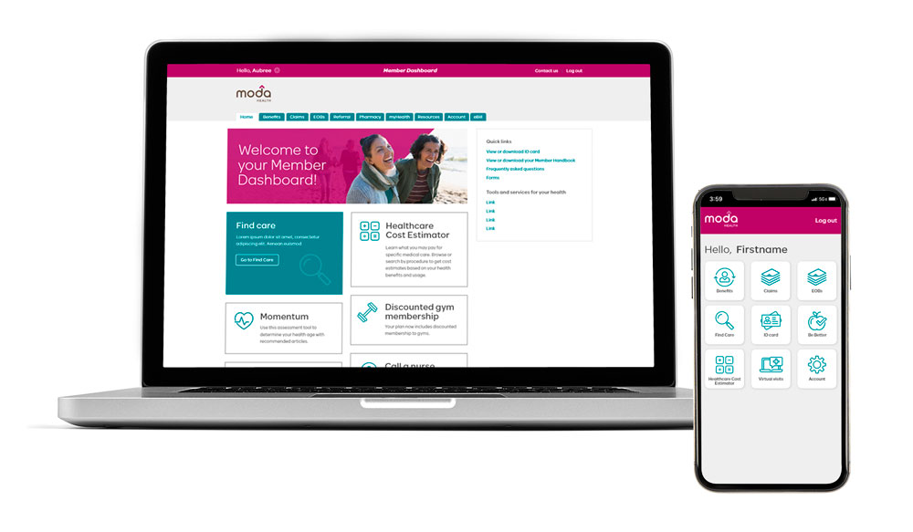
Member Dashboard – your personal member website
See your benefits and Member Handbook
Check claims and review electronic
explanations of benefits (EOBs)
Download your member ID card
Access member care resources
  Dental Optimizer
Access Moda 360 digital resources
  *NEW* Chat with a Moda 360
  Health Navigator
  Find a HtOW Provider

Slide 11
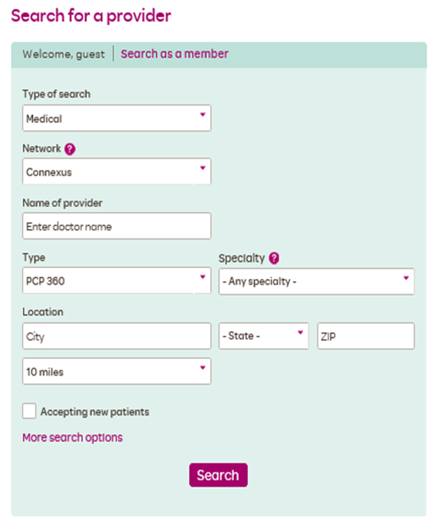
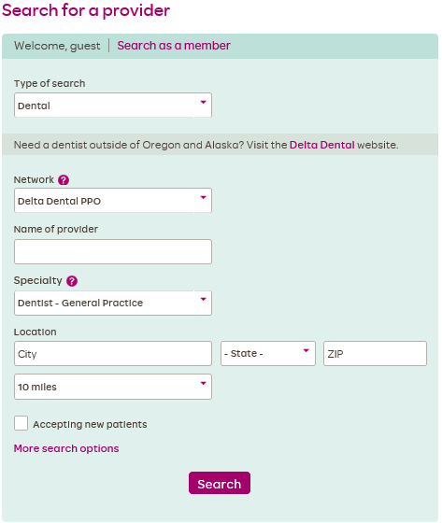

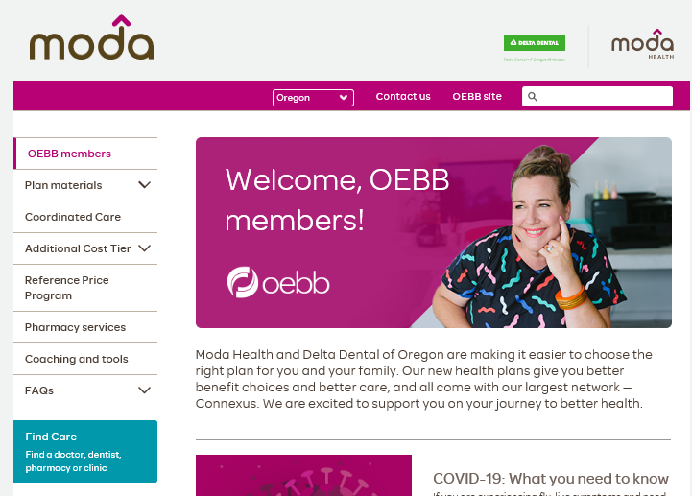

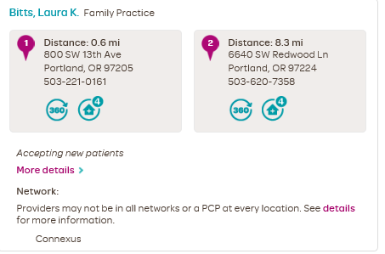
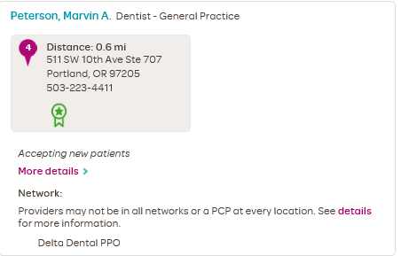
Find Care – Delta Dental’s online provider directory
Search for providers in your network
Click on Find Care on the Moda/OEBB homepage

Slide 12



Your Moda 360 Health Navigators
Available Monday through Friday from 7:30 a.m. to 5:30 p.m. Pacific time.
Medical/Vision
866-923-0409
Pharmacy
866-923-0411
Dental
866-923-0410
Or email Moda at OEBBquestions@modahealth.com
You can also message a Health Navigator instantly through your Member Dashboard

Slide 13
Thank you

