Slide 1

OEBB 2021-22
Open Enrollment: Medical Plans 6 and 7 - High Deductible
Health Plans

Slide 2

High-deductible health plans (HDHPs)
Moda Health offers two HDHPs: Medical Plans 6 and 7
Both are available in either coordinated or non-coordinated care
  Both plans use the Connexus Network
HDHPs are designed to be paired with a health savings account (HSA), but you are not required to enroll in an HSA to be in plans 6 or 7

Slide 3
Overview of Medical Plans 6 and 7
 | Medical Plan 6 Coordinated (choose a PCP 360) | Medical Plan 6 Non-coordinated | Medical Plan 7 Coordinated (choose a PCP 360) | Medical Plan 7 Non-coordinated
Subscriber-only deductible | $1,600 | $1,700 | $2,000 | $2,100
Family deductible | $3,400 | $3,400 | $4,200 | $4,200
Out-of-pocket max per person (subscriber-only and family plans) | $6,400 | $6,750 | $6,500 | $6,750
Out-of-pocket max per family | $13,500 | $13,500 | $13,500 | $13,500
Pharmacy value tier* | $4 |  | $4
Major medical prescription coverage | 20% (subject to deductible) | 25% (subject to deductible) | 20% (subject to deductible) | 25% (subject to deductible)
*Deductible waived

Slide 4


How to choose a Moda Health PCP 360
Call a Moda 360 Health Navigator at 866-923-0409. You can also message one instantly through your Member Dashboard or email them at oebbquestions@modahealth.com.
Log in to your
Member Dashboard
Each enrolled member can choose their own PCP 360
The subscriber of the plan may also choose a PCP 360 for all covered members, including their spouse or domestic partner and dependents, even if they are over the age 18

Slide 5
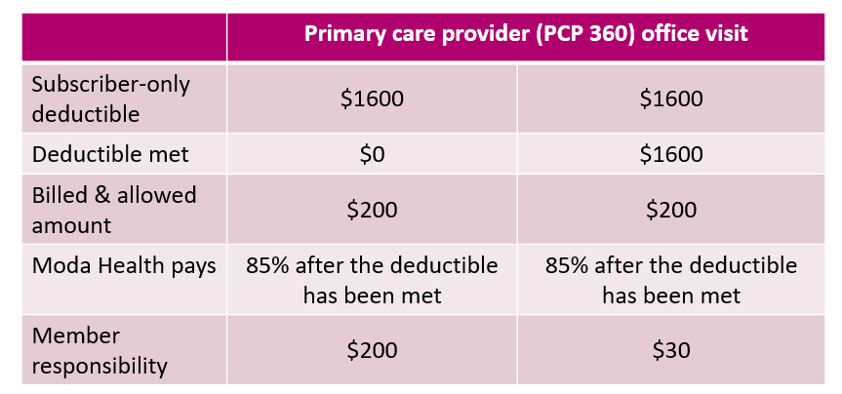
Overview Medical Plans 6 and 7 (cont.)
Preventive services covered in full; all other services are subject to deductible and coinsurance (example below)
Deductible and coinsurance apply to out-of-pocket maximum

Slide 6
Benefits of a health savings account (HSA)
Use HSA tax-free dollars to pay for:
  Deductibles
  Coinsurance
  Qualified medical expenses not covered by your plan
  Qualified dental expenses
  Qualified vision expenses
    You are responsible for
    keeping receipts for expenses paid using your HSA funds
The money in your HSA account is yours and it carries forward each year!

Slide 7


Eligibility for an HSA
You are covered by a compatible High Deductible Health Plan (HDHP), such as Medical Plans 6 and 7
You are not enrolled in Medicare or Tricare
You have not received medical benefits through the Department of Veterans Affairs during the preceding three months
You are not claimed as a dependent on another person's tax return

Slide 8

Health savings account resources
Moda Health administers the HDHP plan, not the HSA
Contact your employer to find out if they partner
with an HSA vendor
You may also contact your preferred financial institution
to set up an HSA

Slide 9

Pharmacy changes
Moda Health will change its pharmacy benefit manager to Navitus Health Solutions on October 1, 2021
All Moda Health Medical members will receive a new ID card with new information to share with their pharmacies
If you have not yet received your new ID card – the following information will need to be updated at your Pharmacy:
    Bin: 610602
    PCN: NVT
    Rx Group: OEBB
    You can download a digital copy of your ID card from your Member Dashboard at modahealth.com/memberdashboard

Slide 10

Pharmacy (Effective 10/1/21)
Starting 10/1/2021 Walgreens will be an in-network pharmacy and CVS will be an out-of-network pharmacy. Members impacted by a pharmacy network change will be sent a letter at least one month in advance
  Please reference the letter for any action needed. You may receive more than one letter if you are affected by more than one change
  You can use the Pharmacy search tool in your Member Dashboard to search for network pharmacies
Costco will be an in-network mail order pharmacy in addition to Postal Prescription Services (PPS)
Members impacted by a formulary change will be sent a letter about the change two months in advance
  Please reference the letter for any action needed. You may receive more than one letter if you are affected by more than one change
Members with a current pharmacy prior authorization on file will not need to seek a new prior authorization
To continue to access your previous prescription claims history, please log in to your Member Dashboard prior to 9/30/21. Then select the Pharmacy tab on the top of the screen and click the MedImpact member portal link in the Resources box. Click Here

Slide 11



| Health Navigators
Available Monday through Friday from 7:30 a.m. to 5:30 p.m. Pacific time.
Medical/Vision
866-923-0409
Pharmacy
866-923-0409
Dental
866-923-0410
Or email Moda at OEBBquestions@modahealth.com
You can also message a Health Navigator instantly through your Member Dashboard

Slide 12
Thank you

