Slide 1

OEBB 2021-22
Open Enrollment: Vision Plans

Slide 2
Vision plan options – no changes
 | Opal | Pearl | Quartz
Benefit maximum | $600 | $400 | $250
 | What Members pay
Eye examinations Frequency: Once per plan year | 0%
Lenses Frequency: Contacts or one pair of lenses per plan year | 0%
Frames Frequency: One pair per plan year for members under age 17; One pair per every two plan years for members age 17 and older | 0%

Slide 3

Vision – key things to remember
You may see any licensed ophthalmologist, optometrist
or optician
Receive discounted rate from a Moda Health-contracted provider (use Find Care ― Moda Health’s online provider directory)
Benefits run on a plan year basis (Oct. 1 – Sept. 30)
Benefit maximum includes exam and hardware

Slide 4


Member resources

Slide 5
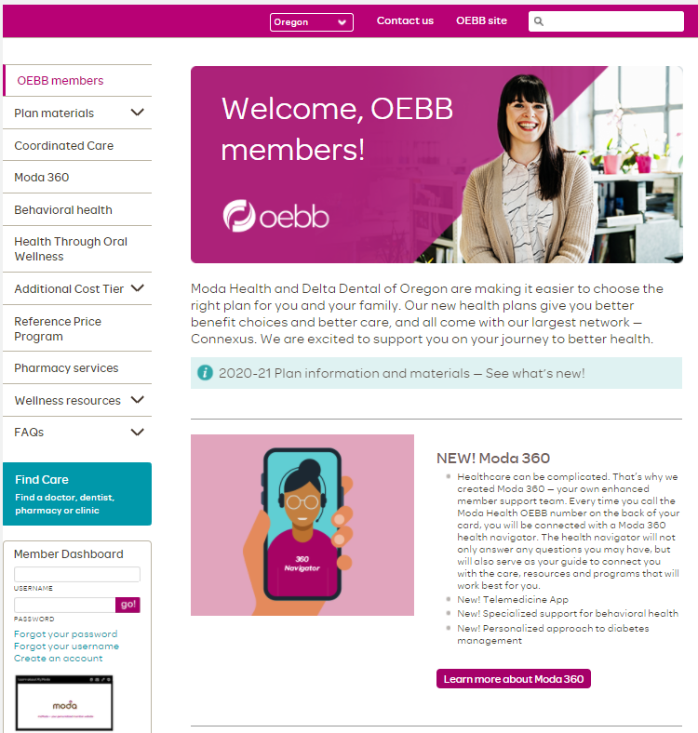
modahealth.com/oebb
Log in to your Member Dashboard here!

Slide 6
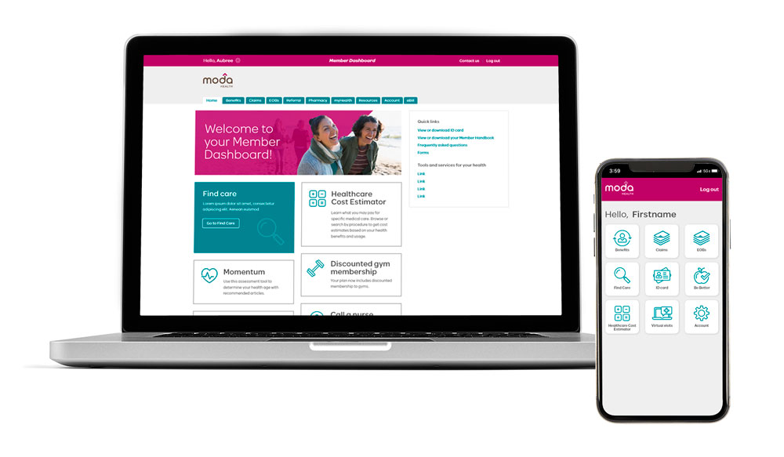
Member Dashboard – your personal member website
See your benefits and Member Handbook
Check claims and review electronic
explanations of benefits (EOBs)
Download your member ID card

Slide 7
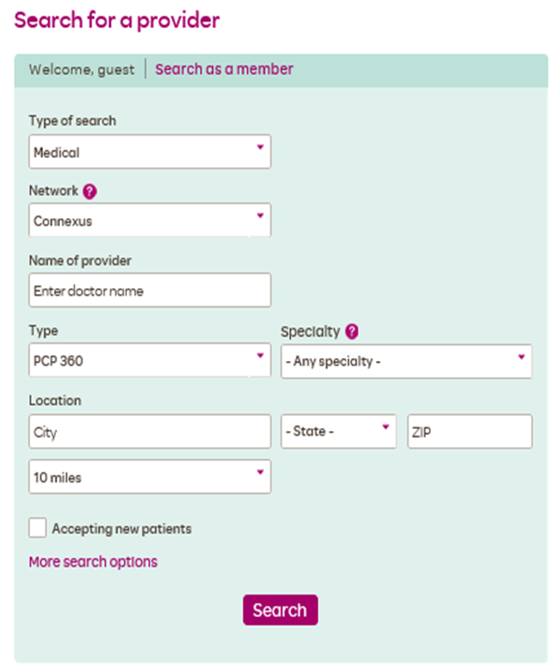
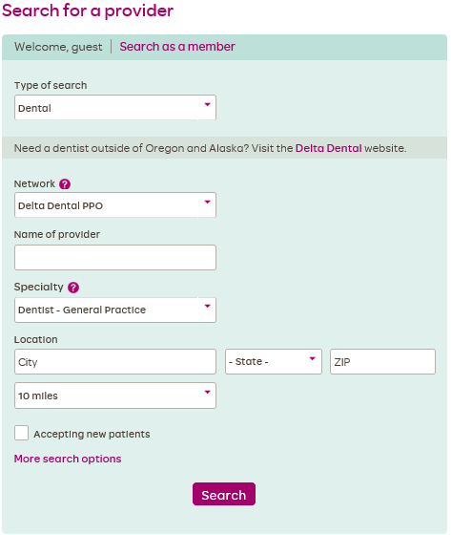

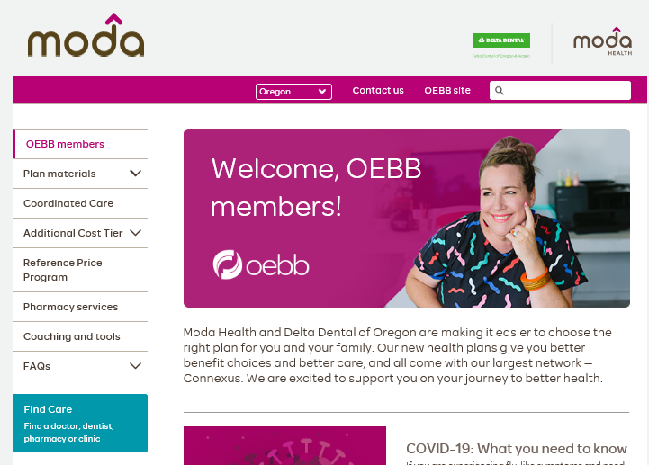

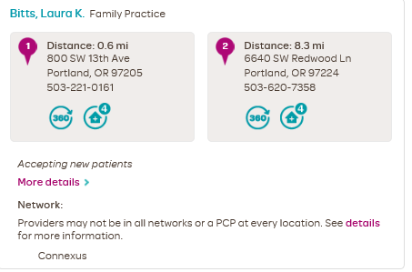
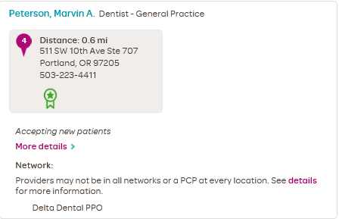
Find Care – Moda Health’s online provider directory
Search for providers in your network
Click on Find Care on the Moda/OEBB homepage

Slide 8




| Health Navigators
Available Monday through Friday from 7:30 a.m. to 5:30 p.m. Pacific time.
Medical/Vision
866-923-0409
Pharmacy
866-923-0409
Dental
866-923-0410
Or email Moda at OEBBquestions@modahealth.com
You can also message a Health Navigator instantly through your Member Dashboard

Slide 9
Thank you

